Slide 1

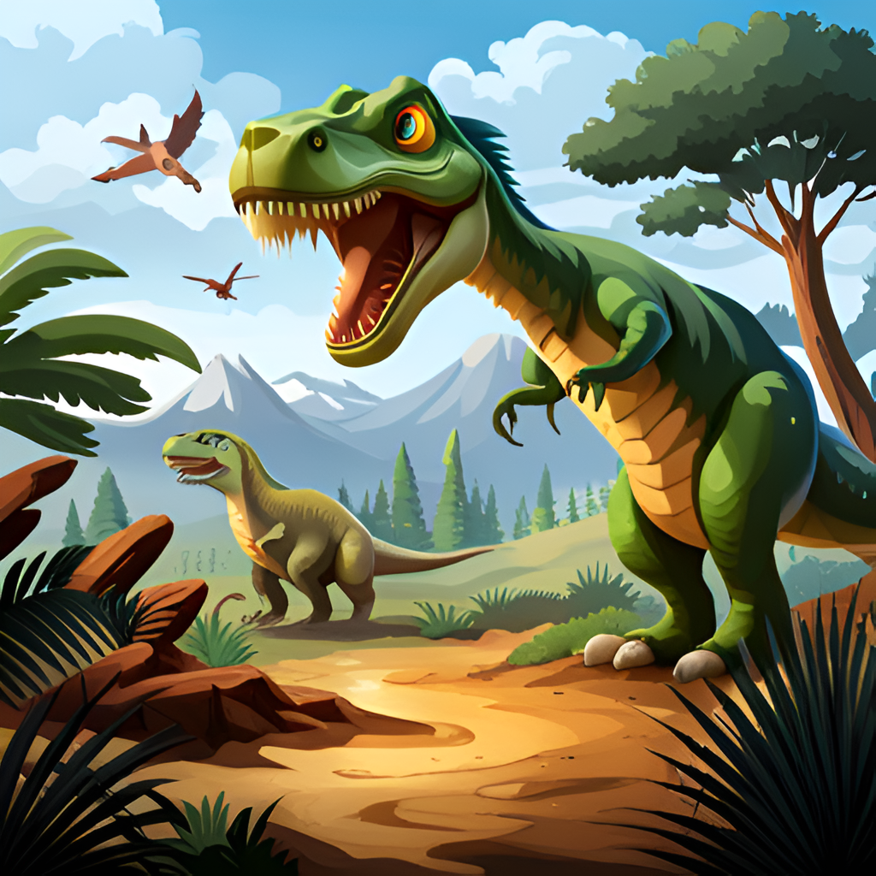
Project: Dino Run
Micah Khatri
Mukhammadyusuf Abdurakhimov
Enerelt Enkhtur

Slide 2
Contents
Ideation
Asset Design
Raylib.h and project setup
Source Code structure
Game preview

Slide 3
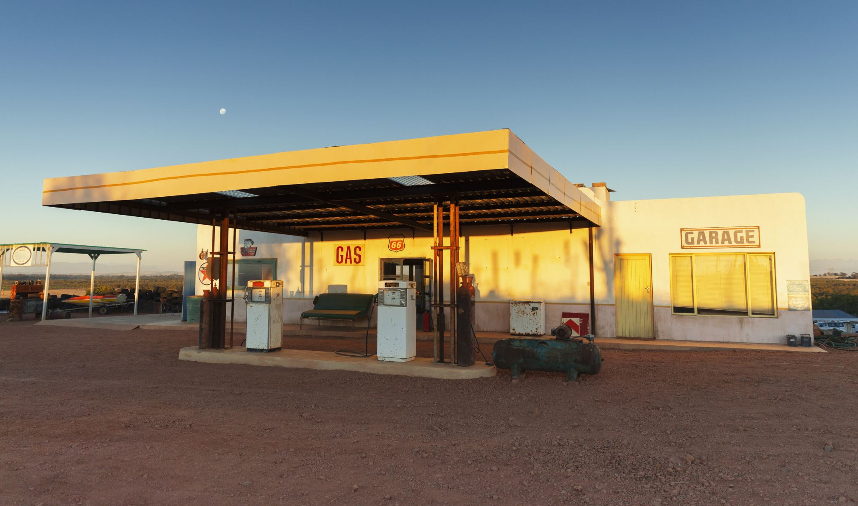
One day we were on the walk to gas station, on a walk and decided to build a dino run game
And here we go!

Slide 4



We started by drawing the pictures

Slide 5
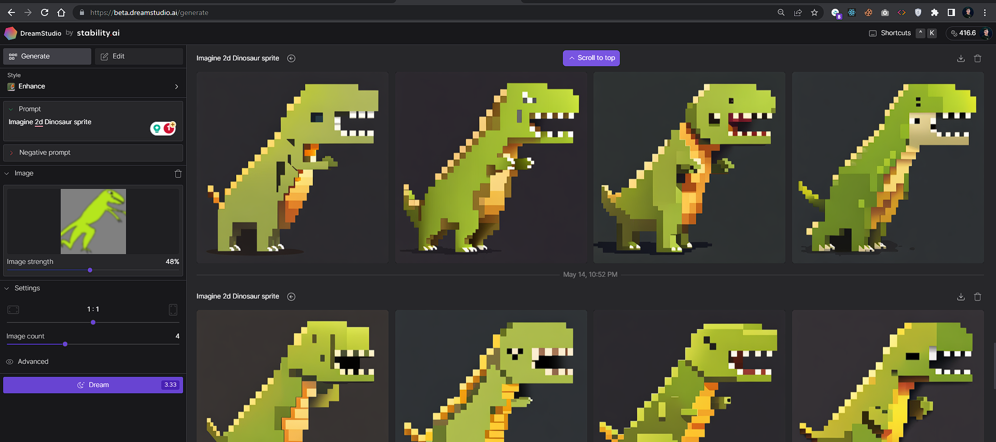
And then we used latest AI technologies to generate our assets in pixels by stability.ai
And then here we go!

Slide 6

“raylib.h” – Project Setup
In order to build the game properly using the graphics library, we had to make our own Makefile. Here are some resources we used on project setup:
https://github.com/raysan5/raylib/wiki
https://github.com/raysan5/raylib/wiki/Working-on-Windows

Slide 7

We coded up the game with just vector graphics first

Slide 8
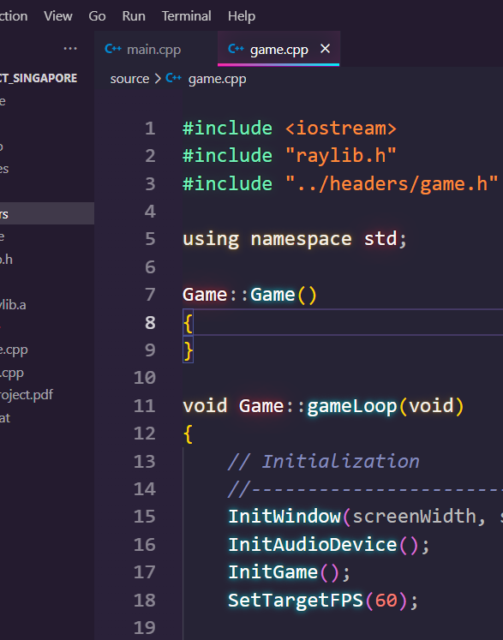
Source Code:
The Game.h class implements the main game loop using an object-oriented approach, ensuring reliable source code delivery.
We have used Structs to define smaller objects like trees
Reader.h class implements file<i/o>, to save the latest highest score or number of plays per session…

Slide 9
Game preview and source code
Source Code structure
Game preview

Slide 10
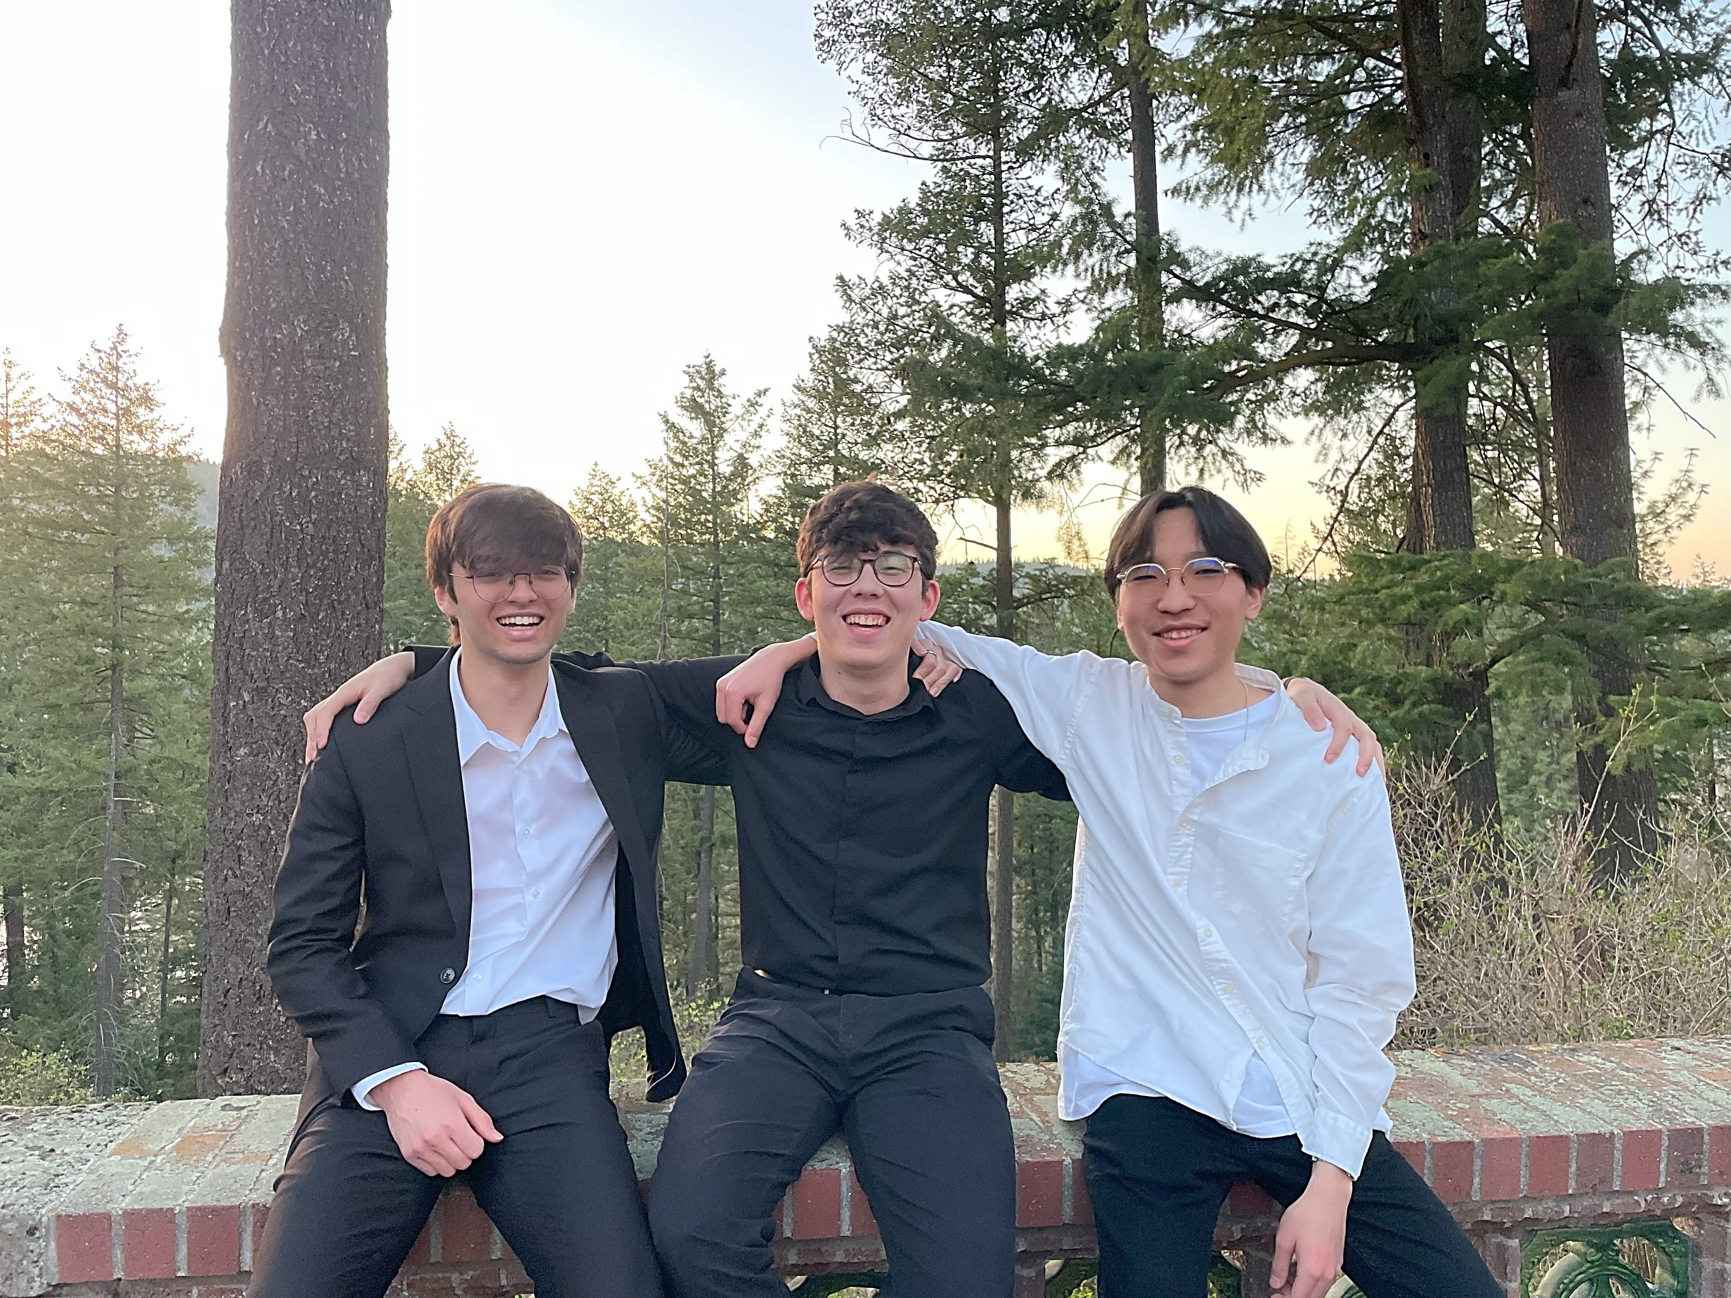
Team: Singapore
M. Abdurakhimov – mabdurakhimov26@my.Whitworth.edu
Enerelt Enkhtur – eenkhtur26@my.Whitworth.edu
Micah Khatri – mkhatri26@my.Whitworth.edu

Slide 11

Thanks for your attention! Any questions?

